Slide 1
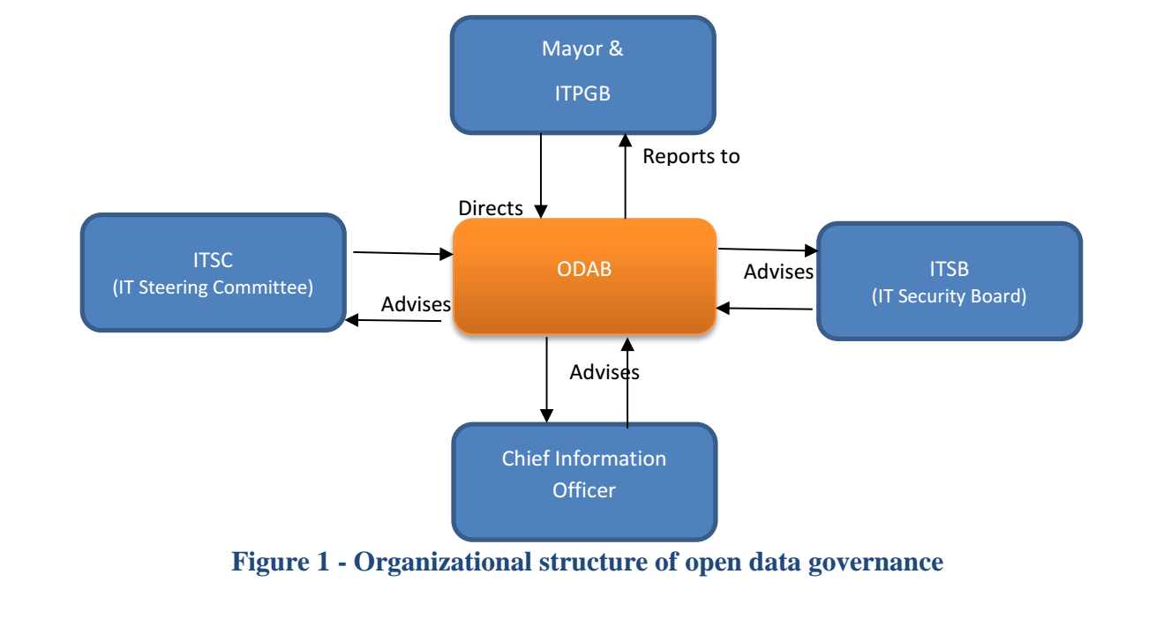
Data Governance in Tulsa, OK
Open Data Advisory Board (ODAB)

Slide 2
Tulsa’s Open Data Advisory Board (ODAB)
Mission:
Provide advisory input to IT Projects Governance Board (ITPGB) for open data portal IT improvements
Create a citywide open data plan and update it annually
Facilitate data publishing with departments
Engage external stakeholders with needed data while contextualizing that data
Membership:
Permanent members: CIO, Mayor’s office, Maximizing and Advancing Performance Office, City Records Manager, Open Data Coordinator from each Department
Ad hoc members: temporary members for specific information technology concerns, citizens interested in discussing specific dataset concerns, Code for Tulsa web development team
Open Data Advisory Board Charter

Slide 3

Tulsa’s Open Data Advisory Board (ODAB) & IT
IT Engagement:
IT representatives on the ODAB
IT is involved in fulfilling internal and externals requests for data (notifying data owners, preparing data for viewing, publishing data to portal, etc.)
ODAB makes technology recommendations to IT Project Governance Board
ODAB works with IT to refresh city’s open data portal

Slide 4
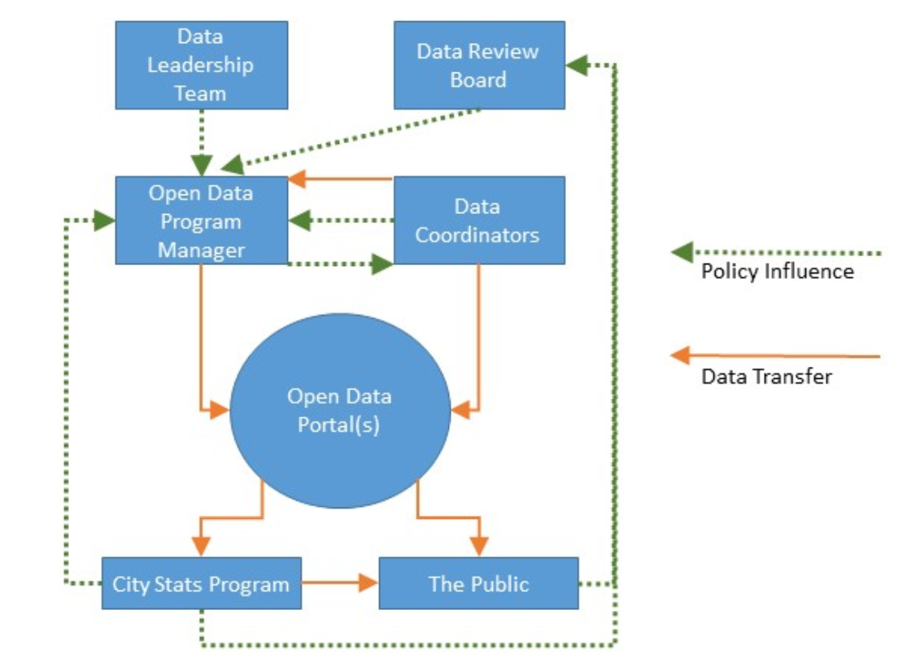
Data Governance in Cambridge, MA
Open Data Program Organization
*Note that some members may belong to more than one group. The open data program manager for example also serves on the open data leadership team.

Slide 5
Cambridge’s Open Data Program
Open Data Review Board Mission:
Gives city staff and residents a voice in the open data program by serving as a forum for discussions about open data policies and about specific datasets
Open Data Review Board Membership:
Three city residents and four city staff and will report to the City Manager
Open Data Leadership Board Mission:
Assists the program manager with decisions and policies that require specialized knowledge of city operations, legal matters, or technical systems
Open Data Leadership Board Mission:
City Manager/Deputy City Manager, Open Data Program Manager, Communications Director, City Solicitor, IT Director, Assistant Director of IT Applications, Data Coordinators, City Analysts

Slide 6

Cambridge’s Open Data Program & IT
IT Engagement:
IT representatives on the Data Leadership Team and Review Board
IT is involved in Cambridge’s open data program (oversees the technical aspects of open data, such as maintaining the public data catalog, extracting data from internal IT systems, and ensuring public data is kept up to date)

Slide 7
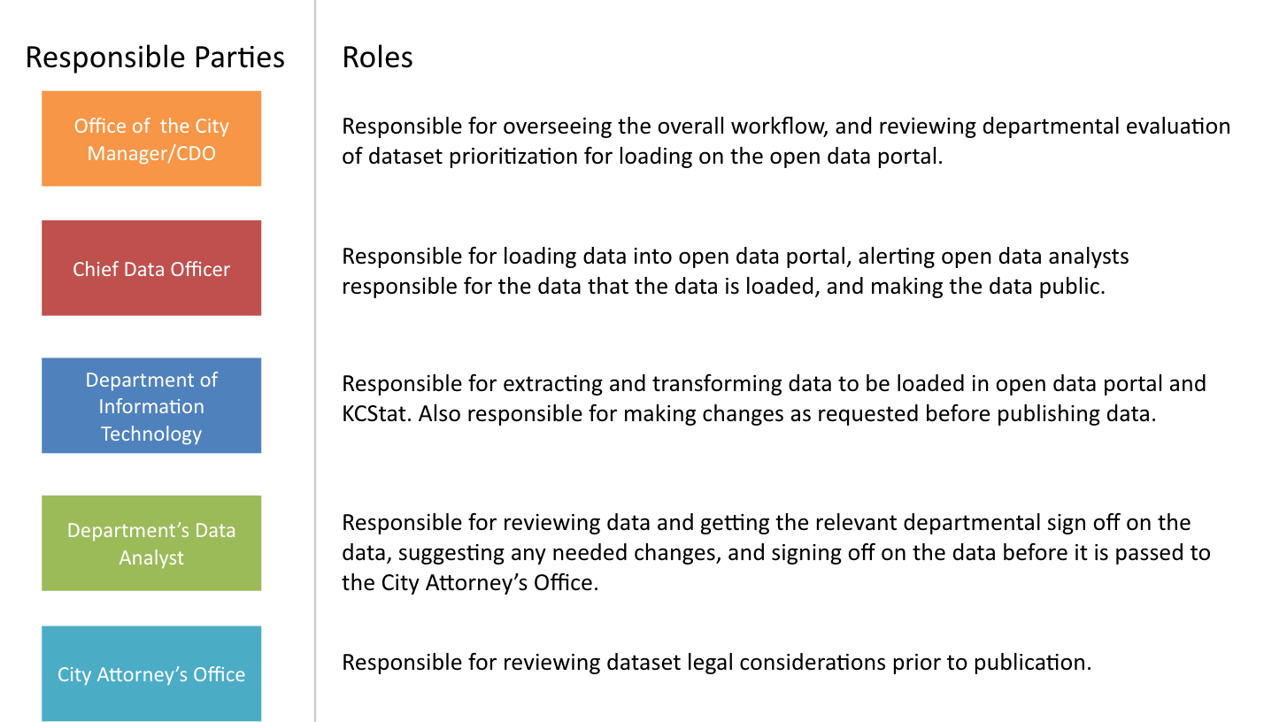
Data Governance in Kansas City, MO
Open Data Governance Committee

Slide 8

Kansas City’s Data Governance Committee
Mission:
Give as many people access to user-friendly data as possible
Establish cross-cutting data conversation
Membership:
City Manager’s Office, City Planning and Development, General Services, KC Fire Department, Law, Neighborhood and Housing Services, Parks and Recreation, Public Works, and Water Services representatives

Slide 9

Kansas City’s Data Governance Committee & IT
IT Engagement:
IT facilitates the extract, transform, and load steps of the open data process
IT has representatives on the open data governance committee

